Slide 1

Session 4: Advanced HMI
Tommy Morris
Professor, Electrical and Computer Engineering
Director, Center for Cybersecurity Research and Education
University of Alabama in Huntsville

Slide 2
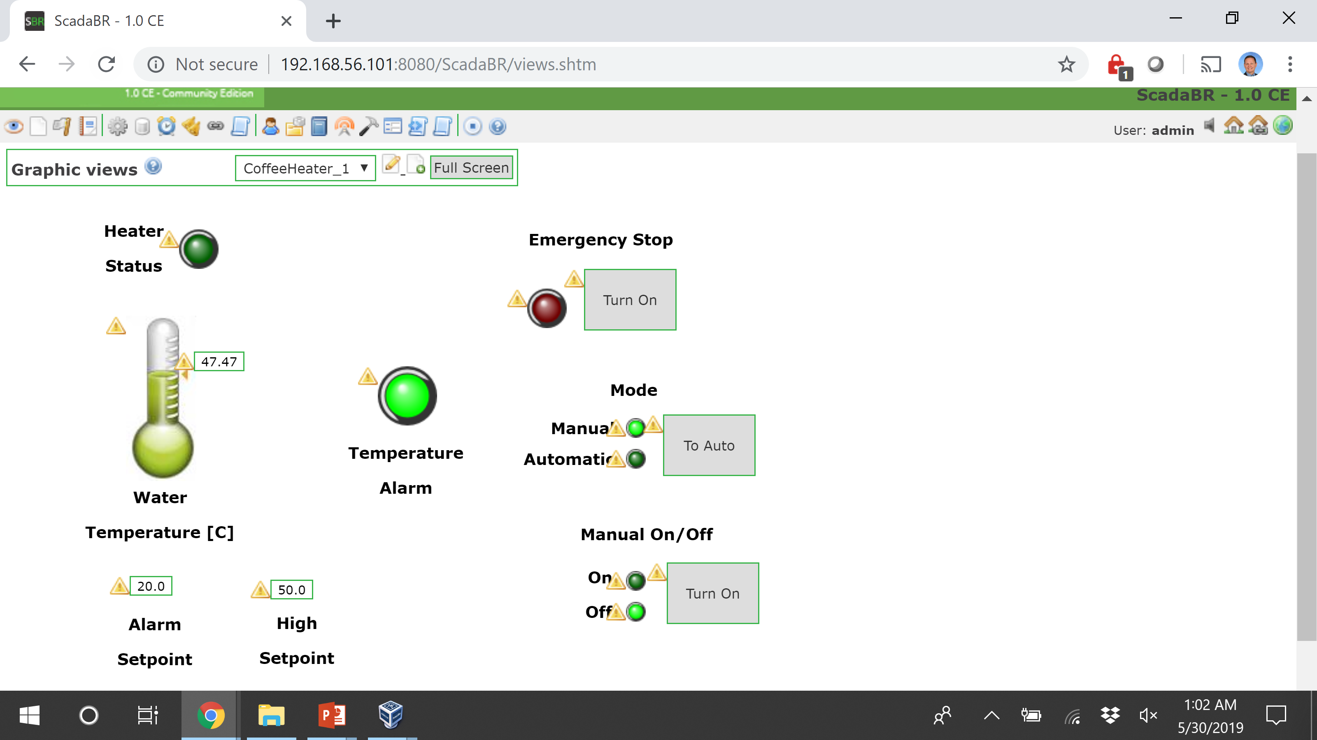
Connection Errors
Make sure the data sources are enabled.
Make sure your PLC is reachable over the network.
Is it running?
Is the correct program running?
Is the network up?

Slide 3
Connection Errors
For the Arduino setup the PLC is running on the host PC.
The SCADABr is in a VM with a host-only network configuration.
From SCADABr the PLC is reached at 192.168.56.1
This address is configurable in Virtual Box
The host IP address can be found (and set) under Preferences -> Network -> Host Only Networks
Select the appropriate adapter

Slide 4
CONNECTION ERRORS
Under Data Sources: Use the Transport Type “TCP with Keep-alive”. This prevents the session from closing after a timeout.

Slide 5
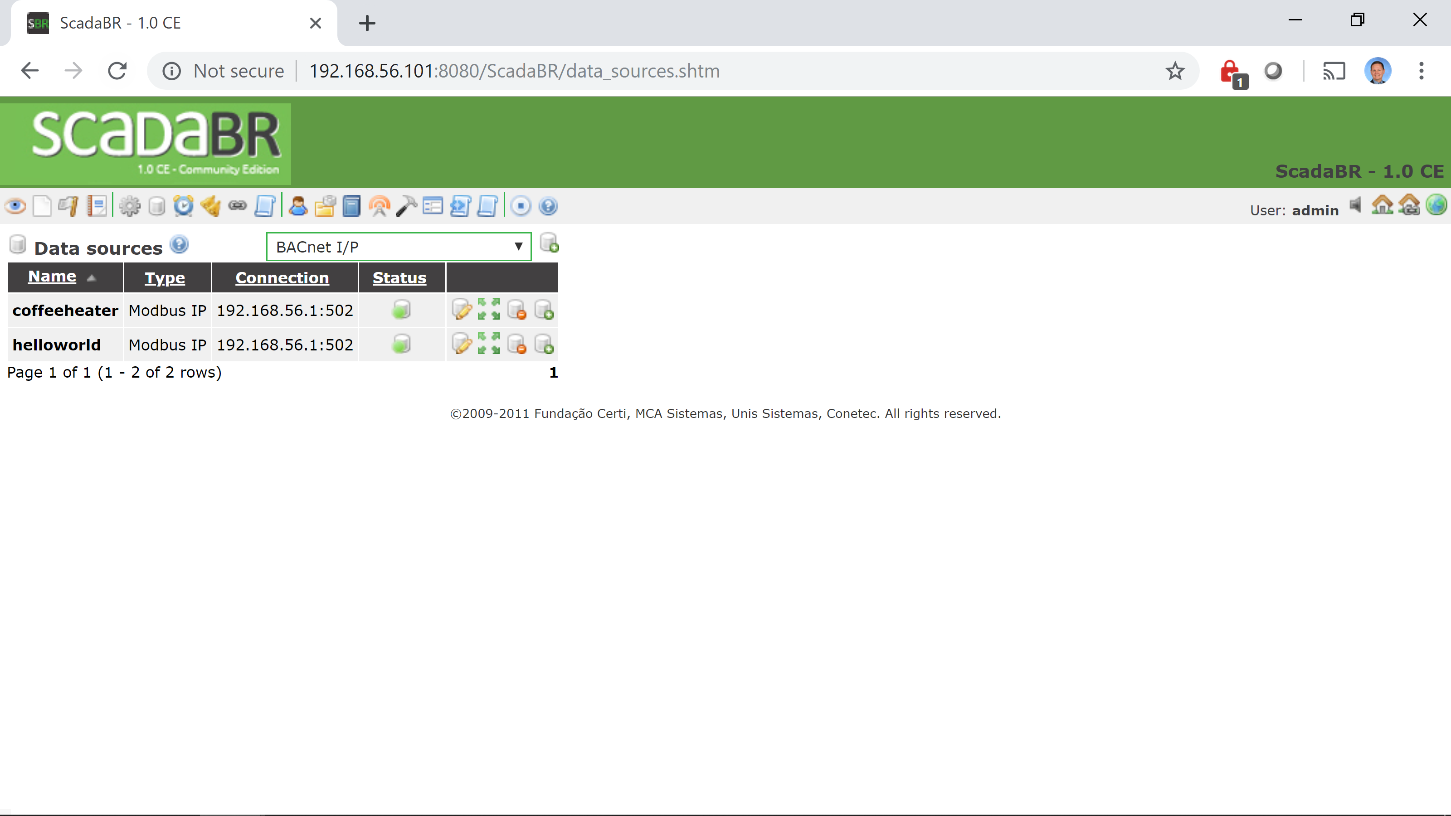


Connection ISSUES
Click here to enable all data sources
on
off

Slide 6
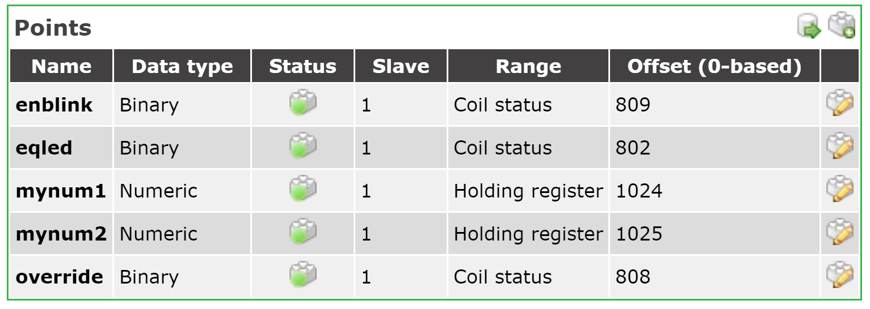
Connection Issues
Click here to edit an individual input output point
Click here to enable all points
Click here to enable an individual input/output point

Slide 7
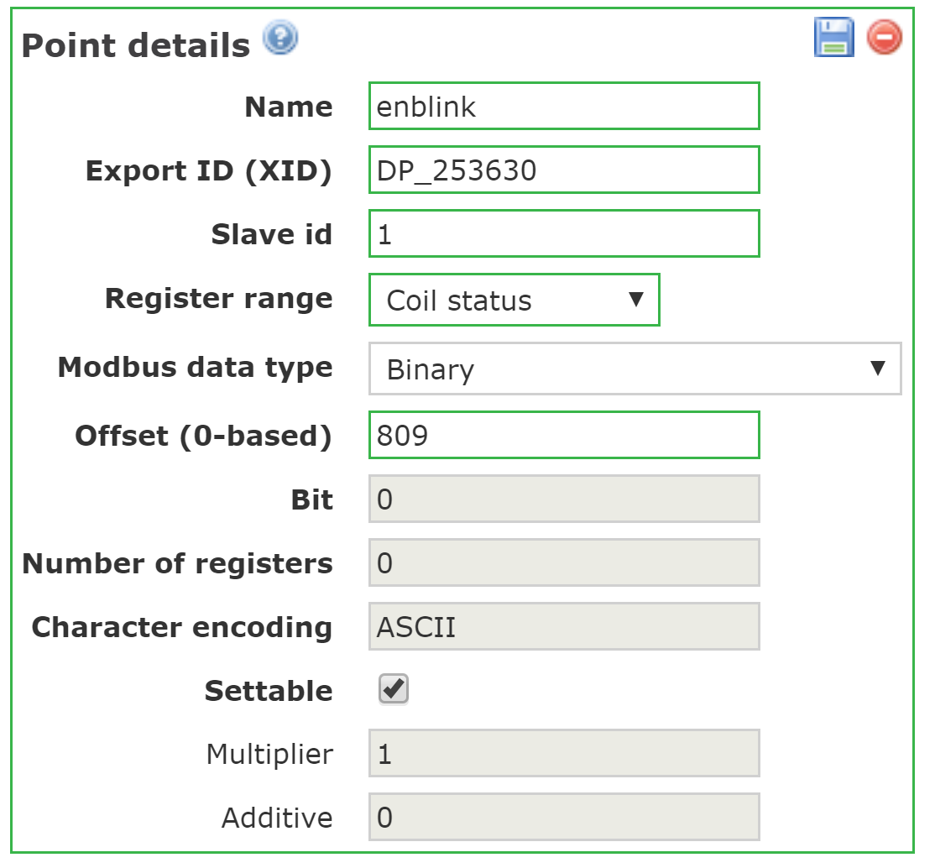
Wrong Data on HMI
Check the
Register range: is this the correct data type?
%IX: Input status
%QX: coil status
%QW, MW, MD, ML: holding register
%IW: input register
Modbus data range: is this the correct data type?
Input status and coil status can only be binary.
The holding register and input register types have multiple valid lengths. Make sure this matches the ladder logic variable type and %QW, MW, MD, ML declaration.
Offset is the address in the Modbus memory map for this variable.

Slide 8
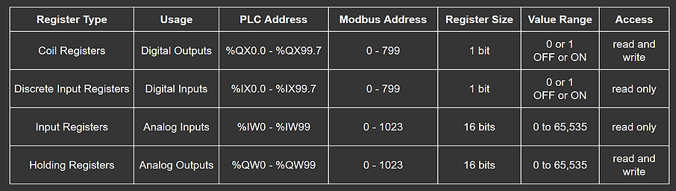
OpenPLC Addressing
I/O Memory Mapping
Address Translation
%QX & %IX
Modbus Address = whole part * 8 + decimal part
%IW & %QW
Modbus Address = whole part + decimal part

Slide 9
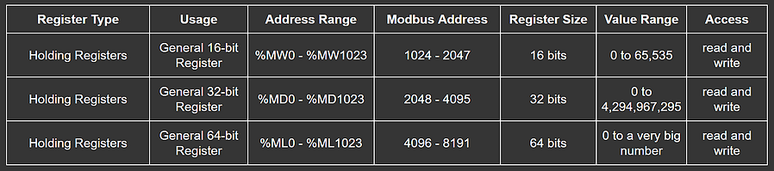
OpenPLC Addressing
Regular Memory Map
Address translation - Modbus register addresses count in 16-bit word units.
%MW Modbus Address = 1024 + whole part
%MD Modbus Address = 2048 + 2*whole part
%ML Modbus Address = 4096 + 4*whole part

Slide 10
OpenPLC I/O Addressing w/Arduino Uno
Type | Arduino Pin | OpenPLC Editor Address | SCADABr Address (aka. Modbus address)
Digital Inputs (Contact) | 2 | %IX100.0 | 800
 | 3 | %IX100.1 | 801
 | 4 | %IX100.2 | 802
 | 5 | %IX100.3 | 803
 | 6 | %IX100.4 | 804
Digital Outputs (Coil) | 7 | %QX100.0 | 800
 | 8 | %QX100.1 | 801
 | 12 | %QX100.2 | 802
 | 13 | %QX100.3 | 803
Type | Arduino Pin | OpenPLC Editor Address | SCADABr Address (aka. Modbus address)
Analog Inputs (input registers) | A0 | %IW100.0 | 100
 | A1 | %IW100.1 | 101
 | A2 | %IW100.2 | 102
 | A3 | %IW100.3 | 103
 | A4 | %IW100.4 | 104
Analog Outputs (holding registers) | 9 | %QW100.0 | 100
 | 10 | %QW100.1 | 101
 | 11 | %QW100.2 | 102

Slide 11
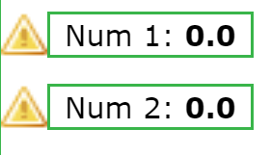
nUMERIC INPUT from the HMI to the PLC - sIMPLE POINT COMPONENT
Analog Graphic -> Simple Point
Displays the value of a register.
Select the point to display.
Warning. Can’t read address over network.

Slide 12
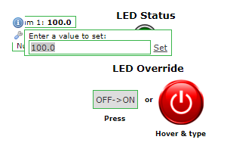
SCADABR Numeric Input
Define variable in ladder logic program
16-bit word: %MW0 - %MW1023
32-bit double word : %MD0 - %MD1023
64-bit long word: : %ML0 - %ML1023
In HMI use Component -> Simple point
Check “settable” in Data Sources
Check “Settable override” and “Display controls” in simple point configuration
Hover over the graphic to set the value
You cannot change the text size.

Slide 13
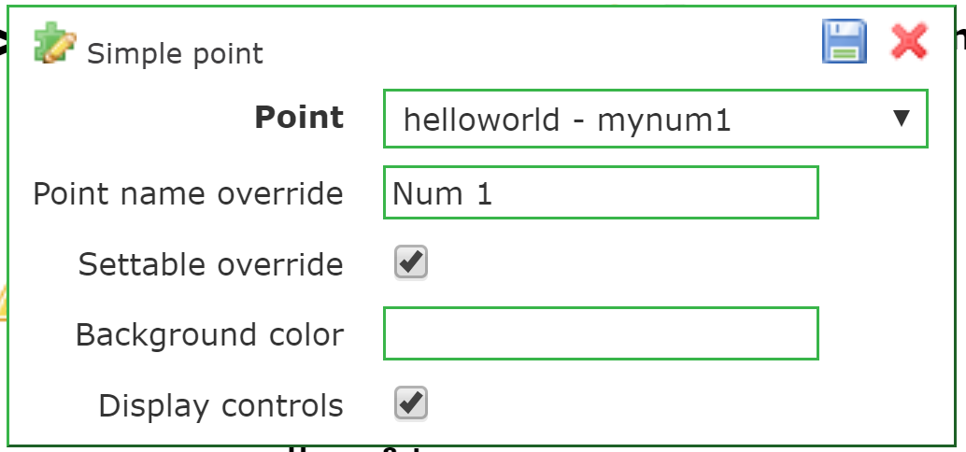
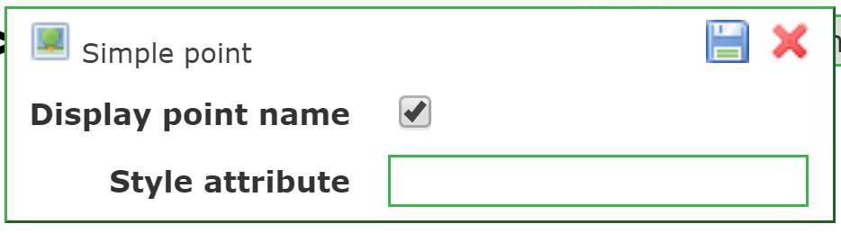
SIMPLE POINT COMPONENT
Config options:
Point name override: display different text
To enable writing from HMI to PLC:
select “Settable override” and select “display controls”
Display point name: select to show point name (with override if selected above)

Slide 14
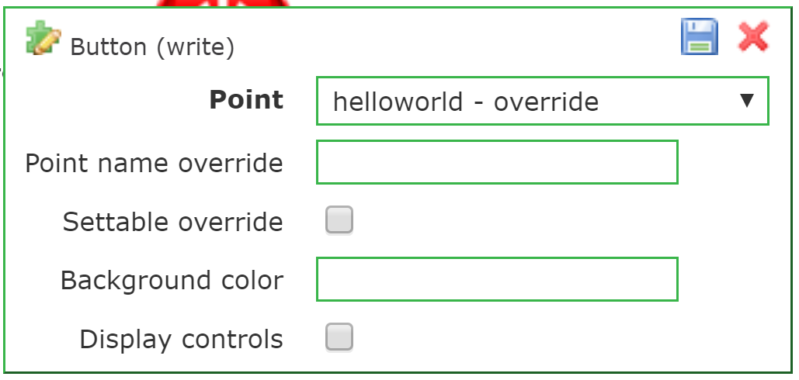
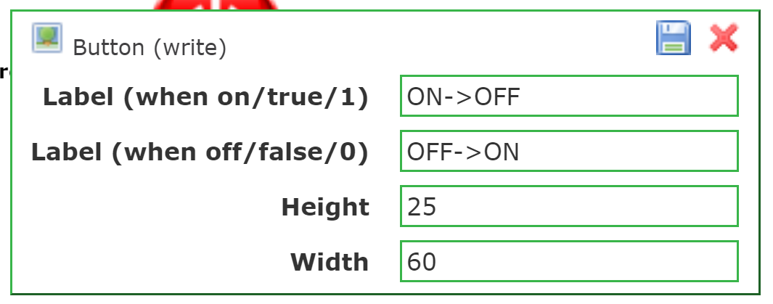
Binary Input FROM HMI
Method 1: Button (write)
Use Component -> Button (write)
Select point to display/control
Set labels for on/off states
Set height and width
The button will have a different label for each state.

Slide 15
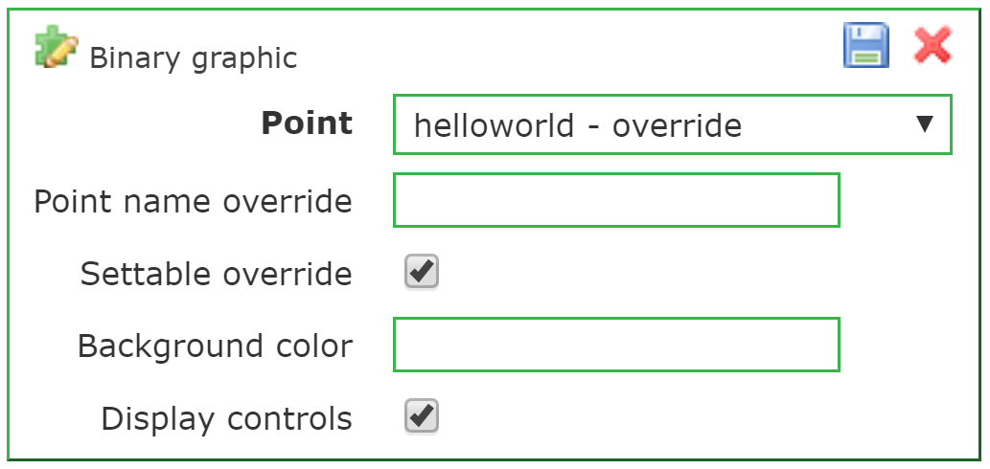
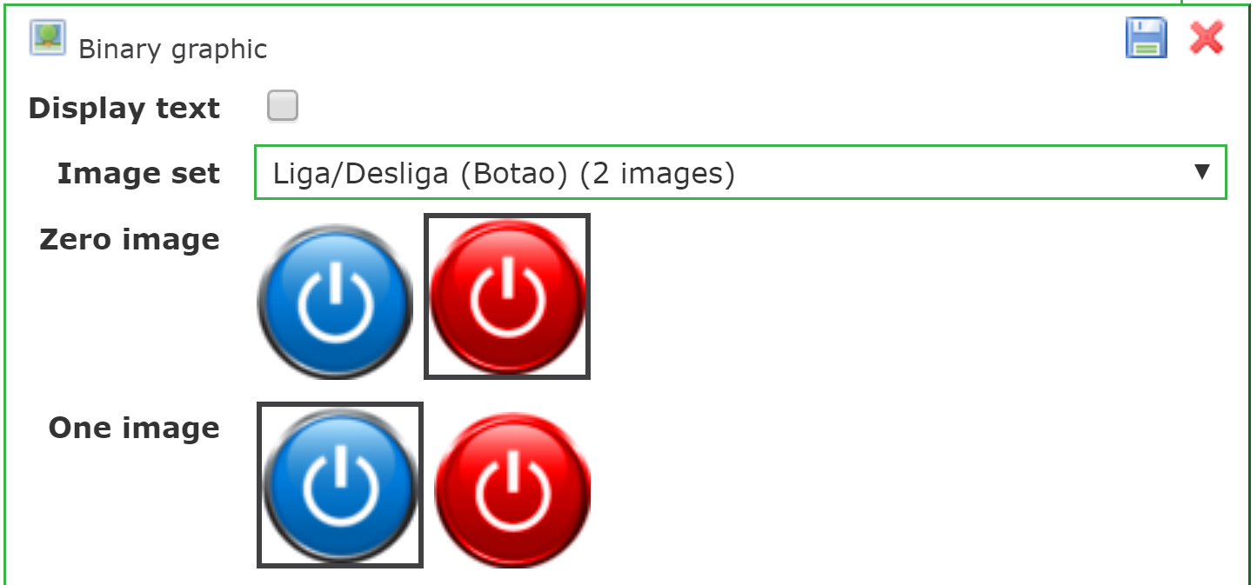
BINARY INPUT FROM HMI
Method 2: Binary graphic
Place a Component -> Binary graphic on the workspace
Select the point
Select “settable override” and “display controls”
Choose an image set Note: these are named in Portuguese. Select each image to see an example of each.
Set the 0 and 1 images.
This method takes input from the keyboard when the user hovers over the image. The image changes according to the setting (0 and 1 images correspond to 0 and 1 settings).

Slide 16
Exercise
Develop Ladder Logic to turn on/off a LED if any of the following three conditions are true.
(1) button press
(2) number1 (16-bit INT) is greater than number2 (16-bit INT)
These should be observable and settable in the HMI
Hint use %MW0 and %MW1
(3) binary input (override) from HMI is 1
Hint use %QX101.0
Develop a corresponding HMI
Display and edit number1 and number2
Display the status of the LED using a binary graphic.
Use a button(write) component to set the override state.

Slide 17
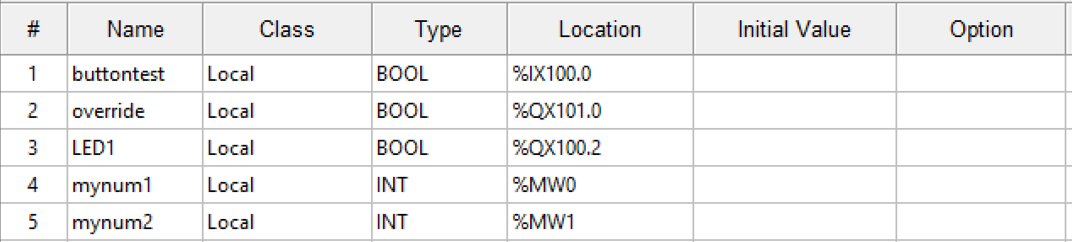
Ladder Logic Solution - Variables

Slide 18
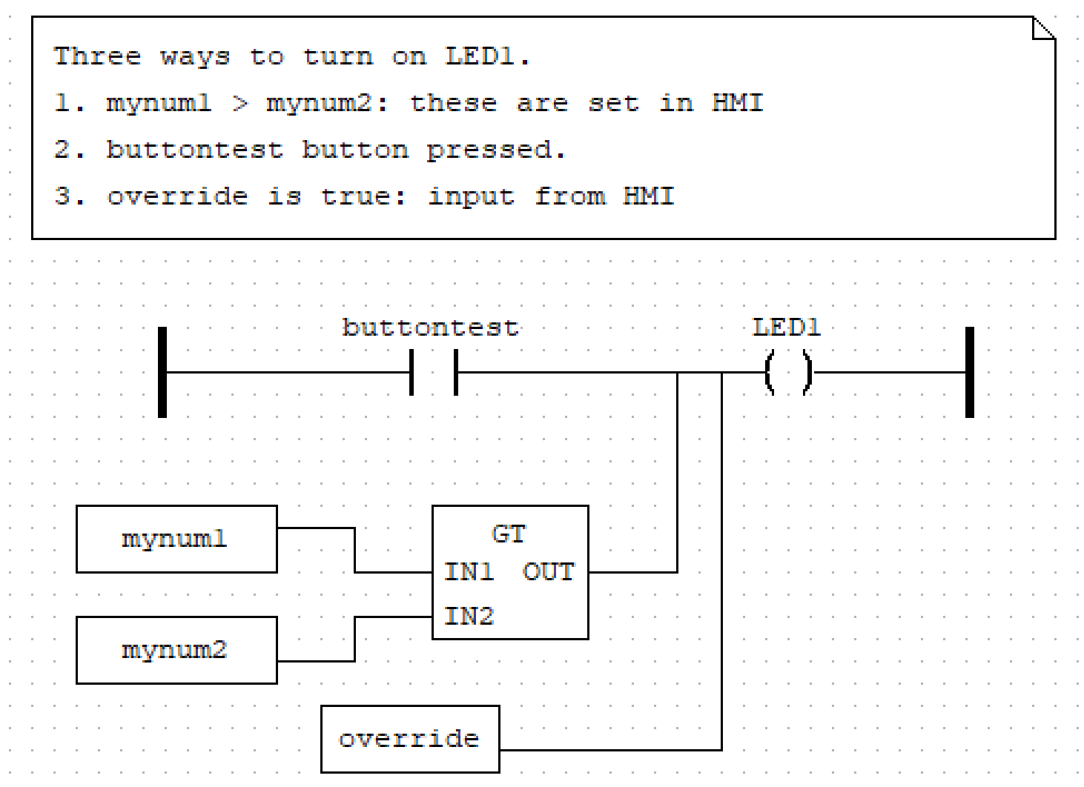
Ladder Logic Solution

Slide 19
Add a Blinking LED
Add a blinking LED that is on for 500ms then off for 500ms
Use two TON function blocks to blink the LED.
Add a binary input to enable the LED from the HMI
Display a blinking LED in the HMI when the LED is blinking

Slide 20
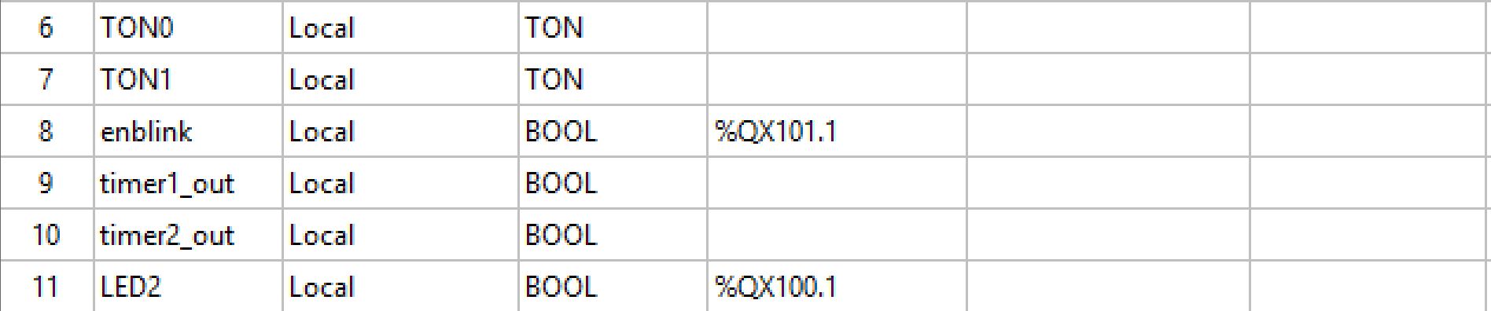
BLINKING LED - Variables

Slide 21
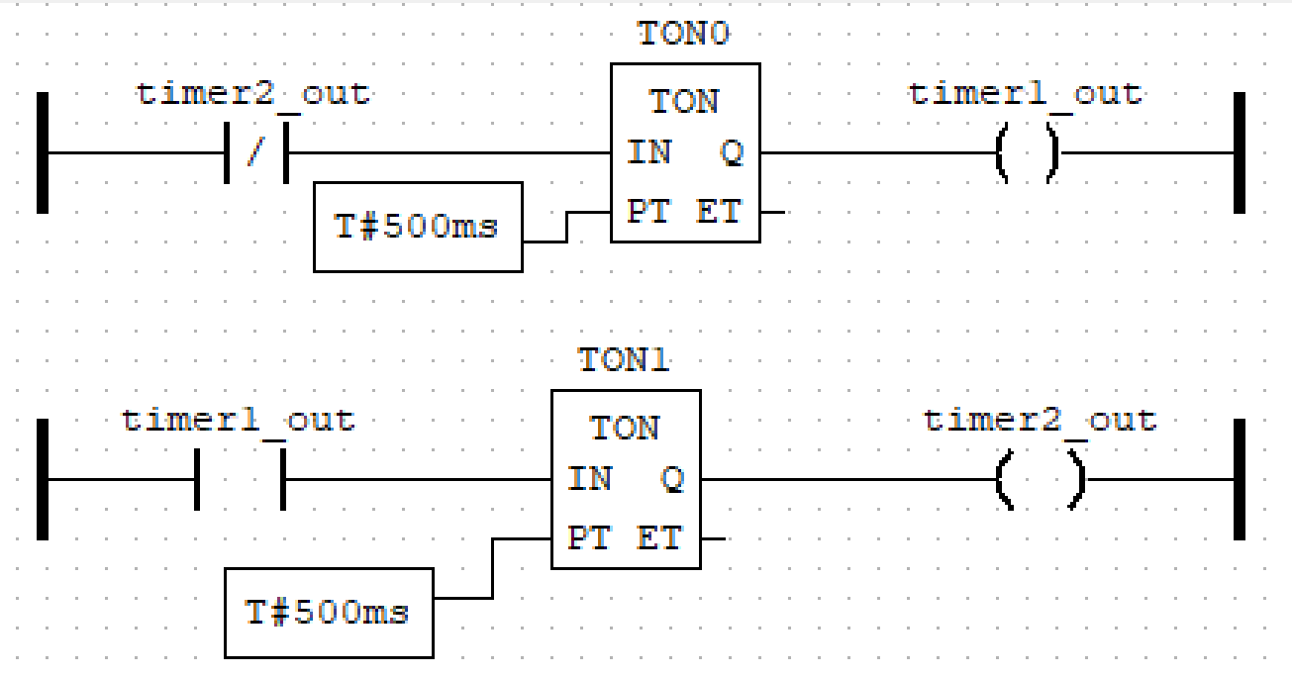
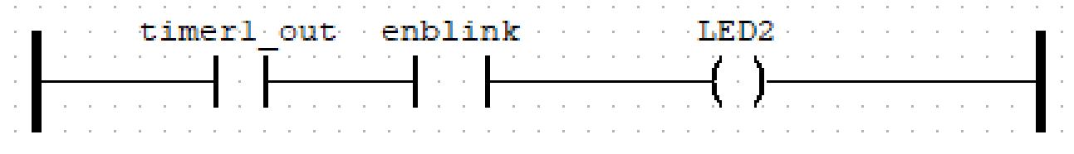
BLINKING LED Ladder LOGIC
At time 0 timer2_out is 0. The negated contact starts TON0. timer1_out starts high while TON0 counts 500ms.
At time 500ms timer1_out goes low. This triggers TON1 to set timer2_out high.

Slide 22
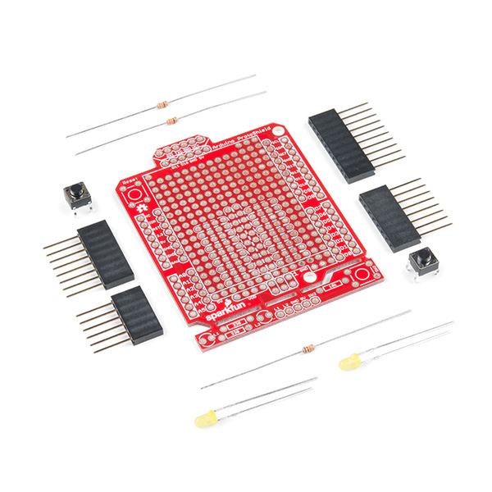
Arduino Shields
Use these expansion boards to build demos that you can reuse.
Solder components to the board.
Resistors, LED, etc.
Less likely to be damaged when storing in a box
Easy to change between demos.
https://www.sparkfun.com/products/13820
There are also similar products called Pi Hats for Raspberry PI.

